Slide 1
Implementation of threshold switching memristor in cadence.
Name:
Kushal kumar k (R24TL003)
School of ECE,
Reva University,
Bangalore.
Guide name:
Dr. Sankar Prasad Bag,
Associate Professor
School of ECE,
Reva University,
Bangalore.

Slide 2
Content
Abstract
Introduction
Literature Review
Problem Statement
Objective
Flow Chart
Methodology
Result
Conclusion
future scope
References

Slide 3
abstract
Threshold switching type of memristors show abrupt resistive transitions beyond a critical voltage making them useful for neuromorphic computing, non-volatile memory and security applications.
A Verilog-A based threshold switching memristor model was implemented in Cadence Virtuoso to study transitions between high and low resistance states, threshold effects and hysteresis dynamics.
Simulations validated sharp threshold-dependent switching and highlighted how physical parameters influence device behavior, switching sharpness and memory retention.

Slide 4
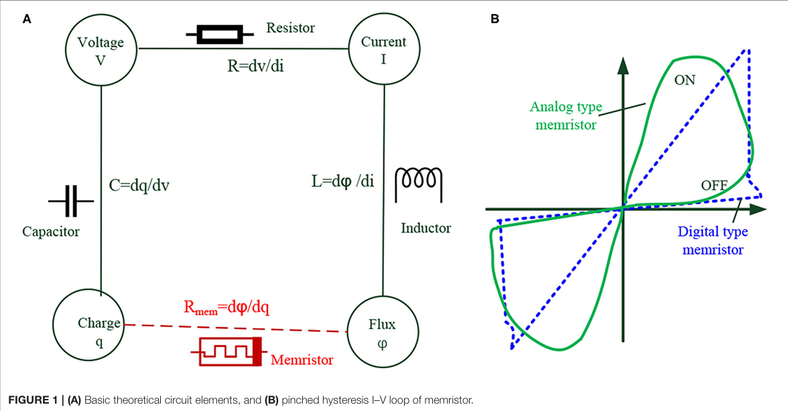
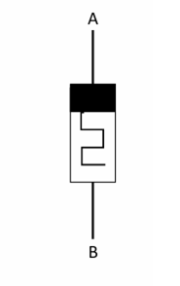
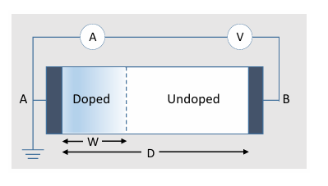
Introduction
Memristors regarded as the fourth fundamental circuit element have attracted significant attention for their ability to combine memory and resistive properties.
Among them threshold switching memristors show abrupt resistance changes once the applied voltage exceeds a critical threshold.
This unique behavior makes them valuable for applications in non volatile memories and neuromorphic computing.
Ref : Advances in Memristor-Based Neural Networks Weilin Xu1,2,3*†, Jingjuan Wang1† and Xiaobing Yan1,4*

Slide 5
Literature Review
Sl. no. | Title of paper | Publishing year | Abstract | Main findings from journal
1 | Memristor-Based Artificial Neural Networks for Hardware Neuromorphic Computing | 2025 | This review explores how memristors can overcome the von Neumann bottleneck in AI hardware by enabling in-memory computing. It covers the evolution of neural networks and memristors | Overview of the memristor and artificial neural networks and how they evolved and their future possibilities of usages.
2 | A Simple Memristor Model for Memory Devices | 2024 | Memristors are favorable and beneficial electronic components, having respectable memorizing and switching behavior. Owing to their minimal energy requirements CMOS high-density integrated circuits. | This paper introduces a simplified and enhanced memristor model for LTSpice, targeting memory arrays. To improve state-variable limits and high-frequency performance.
3 | A Simple Memristor Model for Memory Crossbars | 2024 | Memristors are favorable circuit components with very good commutating and memory properties. They are with small power usage, nano-sizes, and good compatibility to CMOS high-density integrated circuits. | This work extends simplified memristor models to memory crossbars. Comparisons with other models show improved efficiency and correctness

Slide 6
Problem statement
Existing models cannot fully show how memristors switch suddenly at a certain voltage so simulations don’t match real time behavior.
Common circuit design tools don’t naturally support memristors so special models like Verilog-A are needed to study them.
Usage of different materials and no standard libraries make it hard to design with memristors slowing down their use in real electronic systems.

Slide 7
objective
To develop a Verilog-A based model of a threshold switching memristor that captures the essential device physics, including high resistance state (HRS), low resistance state (LRS), threshold voltage, and hysteresis behavior.
To integrate the memristor model into Cadence Virtuoso enabling both device level and circuit-level simulations in a standard VLSI design environment.
To perform simulations in order to validate the threshold-dependent switching characteristics and observe the hysteresis loops.

Slide 8
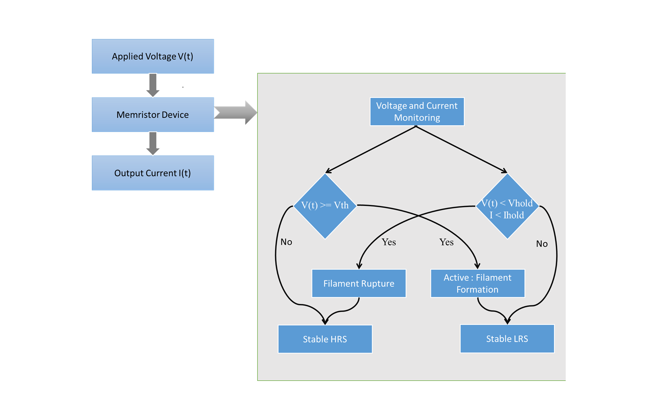
Flow Chart

Slide 9
Applied Voltage (V(t)) : The external voltage applied to the memristor, which drives its switching behavior.
Memristor Device State (s) : Represents the internal state of the memristor determining whether it is in a high resistance state (HRS) or low resistance state (LRS).
Voltage Monitoring : Checks if the applied voltage is greater than or equal to the threshold voltage (Vth). If Voltage < Vth → Device remains in Stable HRS with high current. If Voltage ≥ Vth → Device activates filament formation or phase change, switching to LRS.
Current/Voltage Monitoring : Checks if the voltage is less than the holding voltage (Vhold) and the current is less than the holding current (Ihold). If V < Vhold and I < Ihold → Device undergoes filament rupture/volatile recovery tending back to HRS. Else → Device remains in Stable LRS with small leakage current.
Output Current (I(t)) : The current flowing through the memristor, which depends on whether the device is in HRS (low current) or LRS (high current).

Slide 10
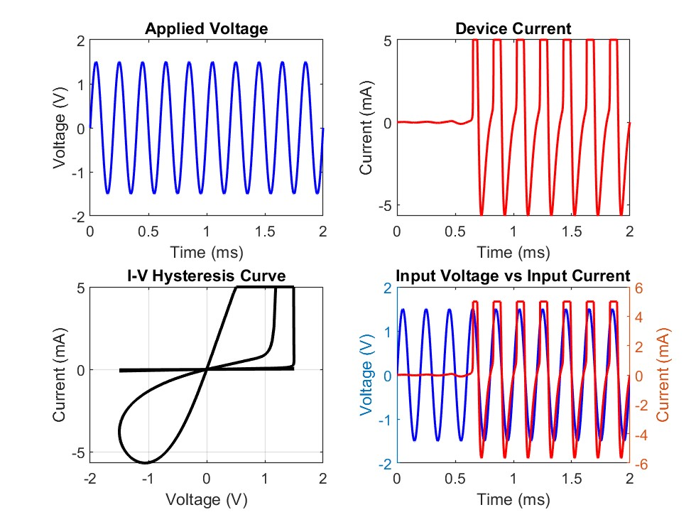
Expected output

Slide 11
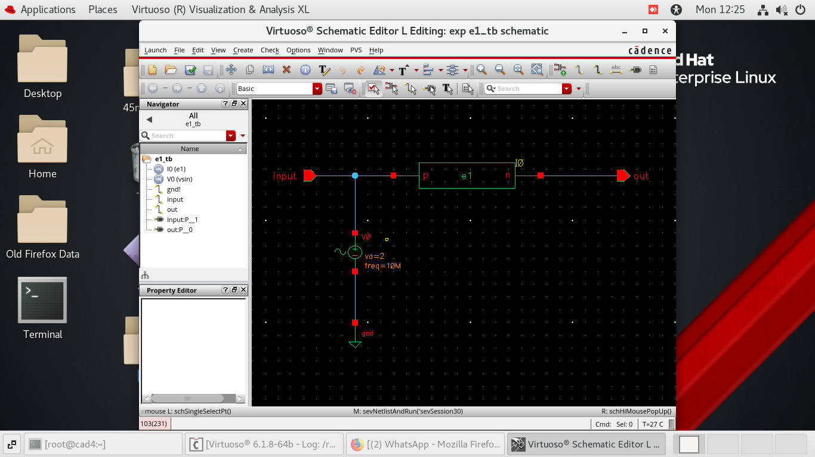
Circuit diagram

Slide 12
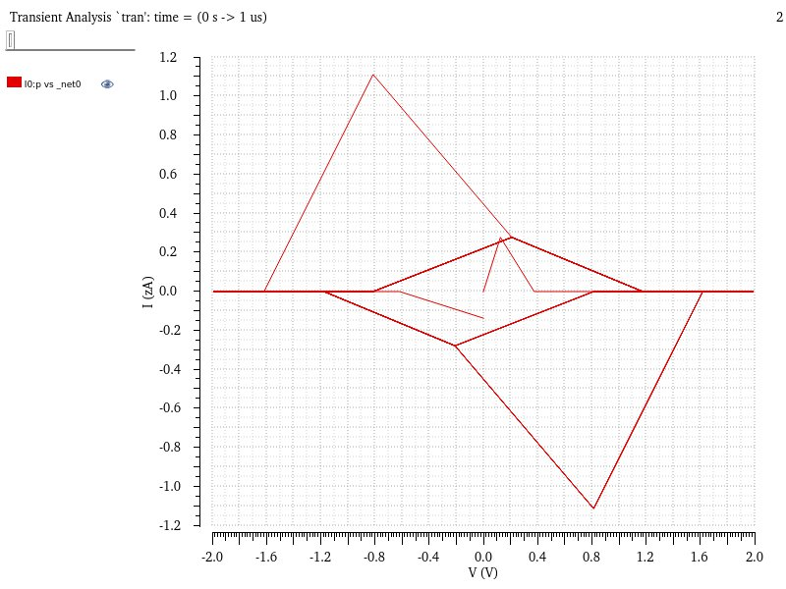
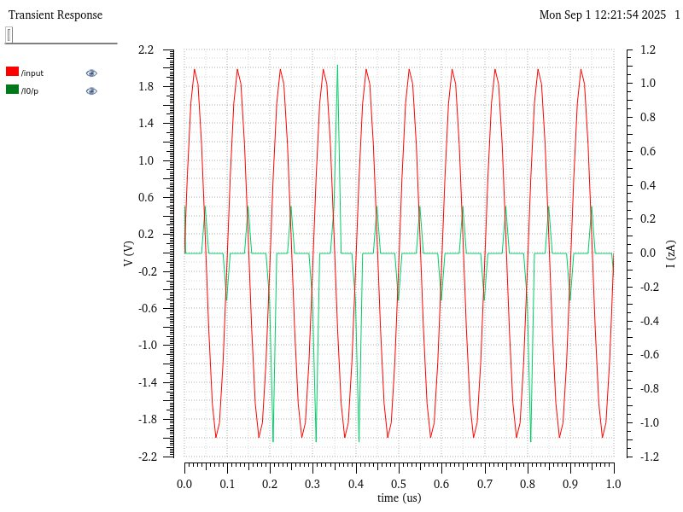
obtained Output’s in cadence

Slide 13
conclusion
The threshold switching memristor component was successfully recreated in Cadence Virtuoso using Verilog-A.
However the simulation results deviated from the expected switching behavior particularly in terms of resistive hysteresis characteristics.
This outcome highlights the need for further refinement of model parameters and simulation conditions to achieve accurate representation and reliable device-level validation.

Slide 14
FUTURE SCOPE
The model can be improved by adding real-world effects like temperature, device wear-out and memory retention so that simulations match actual device behavior better.
Threshold switching memristors can be combined with CMOS circuits to build selectors, oscillators and brain-like systems helping test their use in larger designs.
Future work should also include testing big memristor arrays in simulations and making real hardware prototypes to check scalability and practical performance.

Slide 15
reference
[1] Boyan Jin, Zhenlong Wang, Tianyu Wang, and Jialin Meng. “Memristor-Based Artificial Neural Networks for Hardware Neuromorphic Computing” Research, 2025 (Review Article). https://doi. org/10.34133/research.0758
[2] Stoyan Kirilov.“A Simple Memristor Model for Memory Devices” 2024 International Conference on Modern Circuits and Systems Technologies (MOCAST), IEEE. DOI: 10.1109/MOCAST61810.2024.10615437
[3] Valeri Markov Mladenov and Stoyan Mihaylov Kirilov. “A Simple Memristor Model for Memory Crossbars” 2024 International Scientific Conference on Computer Science (COMSCI), IEEE. DOI: 10.1109/COMSCI63166.2024.10778508
[4] Pengyu Liu, Lekai Song, Kong-Pang Pun, and Guohua Hu. “Threshold Switching Memristor Modeling for Spiking Neuron Design” IEEE Electron Device Letters, Vol. 45, No. 9, September 2024. https://doi.org/10.1109/LED.2024.3424586.
[5] Natasa M. Samardzic, Jovan S. Bajic, Dalibor L. Sekulic, and Stanisa Dautovic. “Volatile Memristor in Leaky Integrate-and-Fire Neurons: Circuit Simulation and Experimental Study”Electronics, MDPI, 2022. https://doi.org/10.3390/electronics11060894

Slide 16
THANK YOU

